Slide 2
Objectives
Understand what is meant by artificial intelligence (AI)
Describe the main characteristics of AI including:
The collection of data and rules
The ability to reason
The ability to learn and adapt
Explain the basic operation and components of AI systems to simulate intelligent behaviour including:
Expert systems
Machine learning

Slide 3
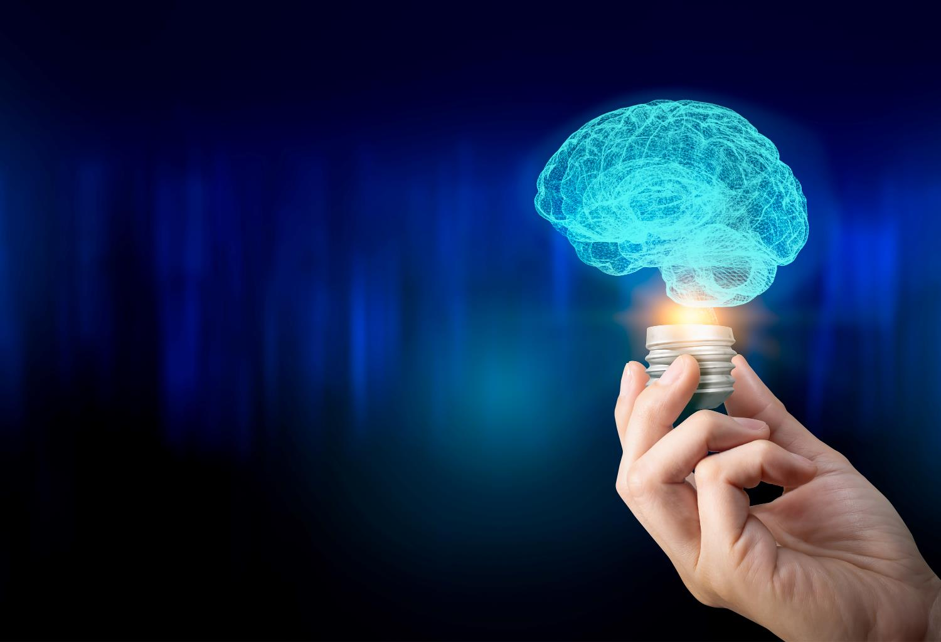

Starter
With a partner, discuss what you think intelligence is

Slide 4
Starter
Intelligence includes the following abilities:
The ability to learn
The ability to understand
The ability to cope with or try new situations
The ability to apply ideas you know to different situations
The ability to think abstractly and discover patterns
Artificial intelligence mimics one or more of these natural intelligence abilities

Slide 5
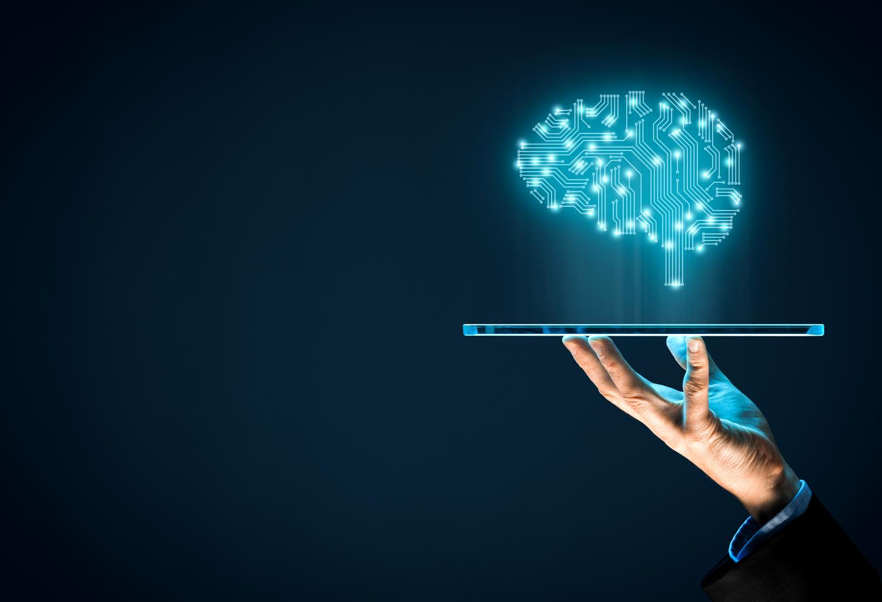
Artificial Intelligence
Artificial intelligence is a branch of Computer Science that deals with the simulation of intelligent behaviours by computers
With a partner, think of three or more examples where artificial intelligence is used

Slide 6
Artificial Intelligence
Some uses include:
Self-driving cars
Natural Language Processing (NLP) tools
Speech recognition, including AI assistants
Conversational help bots
Robotics
Healthcare such as discovering new medicines and detecting diseases
Image recognition
E-commerce product recommendations

Slide 7
Characteristics of AI
There are a number of characteristics of AI including:
Collection of data
Rules for using the data – these rules may be programmed into a program, or the program may discover the rules
The ability to reason
The ability to learn or adapt
Before these are covered, what do you think each of them mean?

Slide 8

Rules
Rules are used by AI to determine the answers to questions
They may be programmed by a human or ‘discovered’ by machine learning
Create a set of rules that determines if a photo shows someone to be happy or sad

Slide 9
Rules
Happy:
Teeth are showing; crease around edges of lips; eyes are wider; edges of mouth raised
Sad:
Eyes more closed; mouth bends down at edges; possibly tears; teeth not showing

Slide 10
Reasoning
Artificial intelligence is able to use reasoning to find out new information based on the rules it is given
A deductive reasoning example:
Humans eat vegetables
Zach is human
Reasoning deduces: Zach eats vegetables

Slide 11
Worksheet 3
Complete Task 1 and Task 2 on Worksheet 3

Slide 12
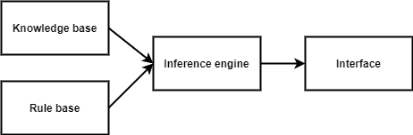
Expert systems
An expert system is a computer program that simulates a human expert
For example, a website that finds the right future career for you could ask a series of questions before suggesting suitable options
Expert systems are made up of:
A knowledge base
A rule base
An inference engine
An interface

Slide 13
Knowledge base and rule base
The knowledge base and rule base are like a database that stores a set of facts and rules
These rules are like IF-THEN statements
For instance, in an expert system that suggests future careers, one rule in the rule base could be:
IF you like football AND you like talking THEN we suggest being a football commentator

Slide 14


Inference engine
Controls the steps taken to solve the problem
You can think of an inference engine as carrying out a large number of IF-THEN type statements to reach a conclusion
There are two ways for an inference engine to work:
Forward chaining – give a number of facts to the system which the inference engine then uses to reach new facts
Backward chaining – give a goal and then determine the facts that are needed to reach a goal

Slide 15
Forward chaining – example
Let’s consider an inference engine for choosing a future career
Which job would you like?
Do you like science? Yes
Do you like working with people? Yes
Do you want to help make people’s health better? Yes
Do you faint if you see blood? No
The inference engine is forward chaining by finding facts to find the following goal:
You should be doctor

Slide 16
Backward chaining - example
In backward chaining the inference engine starts with the goal and then determines all the facts needed to achieve the goal
For example:
Goal: I want to be a doctor
The inference engine backward chains to establish that you need the following:
You must not faint if you see blood
You must want to help make people better
You must like people
You must like science

Slide 17

Interface
The interface is the method in which users interact with the expert system
Interfaces include:
Web pages
Chat bots
Telephone systems
Discuss with a partner an expert system that you have used to solve a problem

Slide 18
Worksheet 3
Complete Task 3 on Worksheet 3

Slide 19
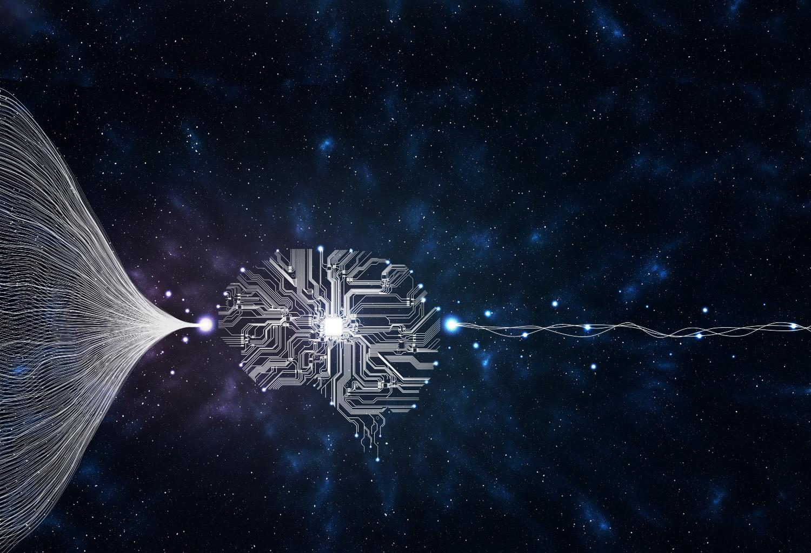

Machine learning
Machine learning is where a program is able to automatically adapt its own processes or data
Rather than giving the program rules, a large amount of data is collected by the program and which then makes its own rules

Slide 20
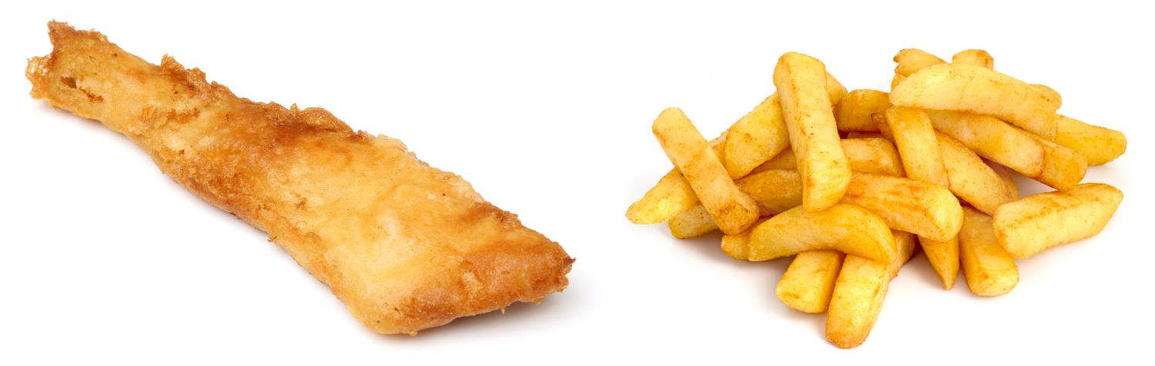
Detecting fish or chips
In machine learning we don’t give the computer the rules to detect the difference
Instead we give sets of data for it to learn from
For instance, we could give a set of properties of many example foods for it to learn from

Slide 21
Machine learning meals
Here are some properties that are given:
Colour of meal
Number of items
Weight
Temperature
Crispness

Slide 22
Machine learning meals
The program has no knowledge of what fish or chips are
What patterns do you think it will find from the following data?
Item number | Golden intensity | Number of items | Weight | Temp | Crispness | Food item
1 | 8 | 1 | 300 | 25 | 9 | Fish
2 | 7 | 2 | 250 | 20 | 8 | Fish
3 | 5 | 20 | 400 | 30 | 4 | Chips
4 | 8 | 1 | 150 | 35 | 7 | Fish
5 | 9 | 1 | 200 | 25 | 8 | Fish
6 | 6 | 15 | 200 | 20 | 5 | Chips

Slide 23
Machine learning rules
The machine learning detects the following rules:
Golden intensity 7-9 is fish; intensity 5-6 is chips
Number of items 15-20 is chips; number of items 1-2 is fish
Weight and temperature can be ignored
Crispiness 7-9 is fish; crispiness 4-5 is chips
Item number | Golden intensity | Number of items | Weight | Temp | Crispness | Food item
1 | 8 | 1 | 300 | 25 | 9 | Fish
2 | 7 | 2 | 250 | 20 | 8 | Fish
3 | 5 | 20 | 400 | 30 | 4 | Chips
4 | 8 | 1 | 150 | 35 | 7 | Fish
5 | 9 | 1 | 200 | 25 | 8 | Fish
6 | 6 | 15 | 200 | 20 | 5 | Chips

Slide 24
Machine learning rules
The machine learning will also give weights to the importance of each property
For instance, a small weight may be given to the Weight property if it is high
A large weight will be given to the number of items as the difference is so big
Item number | Golden intensity | Number of items | Weight | Temp | Crispness | Food item
1 | 8 | 1 | 300 | 25 | 9 | Fish
2 | 7 | 2 | 250 | 20 | 8 | Fish
3 | 5 | 20 | 400 | 30 | 4 | Chips
4 | 8 | 1 | 150 | 35 | 7 | Fish
5 | 9 | 1 | 200 | 25 | 8 | Fish
6 | 6 | 15 | 200 | 20 | 5 | Chips

Slide 25
Worksheet 3
Complete Task 4 on Worksheet 3

Slide 26
Plenary
Fill in the gaps with the words beneath
AI stands for ___________. The main characteristics include the collection of ____________, the ability to ___________ and the ability to learn and adapt.
___________systems are one use of AI. Another technique is ___________. Here ___________ is given to a computer program which then creates its own rules.
training data artificial intelligence reason
data and rules machine learning expert

Slide 27
Plenary
Fill in the gaps with the words beneath
AI stands for artificial intelligence. The main characteristics include the collection of data and rules, the ability to reason and the ability to learn and adapt.
Expert systems are one use of AI. Another technique is machine learning. Here training data is given to a computer program which then creates its own rules.
training data artificial intelligence reason
data and rules machine learning expert

